Slide 1
Data Exchange Framework
Gunnar gestsson – Advania & Dynamics.is
Notes:
Make the audience feel safe

Slide 2




About me
Gunnar Thor Gestsson
Microsoft Dynamics NAV Architect @ Advania
Microsoft MVP
gunnar@dynamics.is | dynamics.is | objects4nav.com

Slide 3
Agenda
Data Exchange Framework
Overview
Process Definition
Line Definition
Column Definition
Field Mapping
Transformation Rules
Notes:
I am going to show you how to use the Data Exchange framework. How, by using the Data Exchange framework you will have more freedom in importing your data into Dynamics NAV. I will show the steps to setup the Data Exchange Definition and how to use Transformation Rules in the import. Then we will talk about the processes we need to define to start the import and finally jump into Dynamics NAV to show one short demo and look at the basic code that drives that demo.

Slide 4
Overview
Usage scenarios in NAV 2016/2017:
Payment Export from Payment Journal
Positive Pay Export
Bank Statement Import to Bank Account Reconciliation
Payroll Import to General Journal
Generic Import
OCR
PEPPOL
Currency Exchange Rates
Custom Data Import
Notes:
Data Exchange has been in Dynamics NAV since version 2013. At that time Microsoft called it Posting Exchange. In version 2013R2 and 2015 Microsoft added some features to the Posting Exchange. In 2016 Microsoft added the Generic Import feature with OCR, PEPPOL and the Currency Exchange Rates Service. At that time Microsoft felt it was time to give the feature a new name – so now we have the Data Exchange Framework.

Slide 5
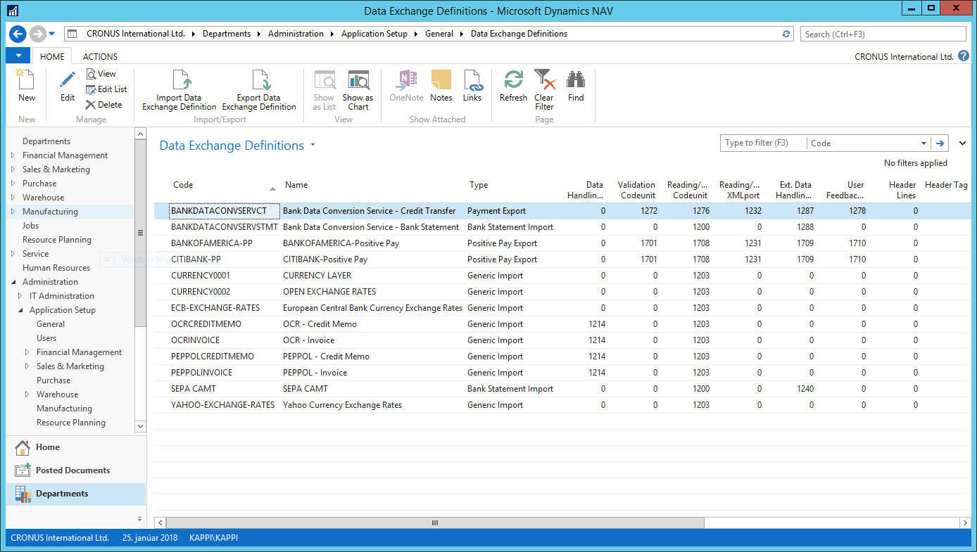
Data Exchange Definitions
Data Import
Data Export
Notes:
So here we are, this is where we create and manage the Data Exchange Definitions. We can see here the definition types available. Today I will focus on the Generic import types. Not like there is anything programmatically different between types, that is – as name is – just an informational field. (click)
The processes are defined; from right to left for data import, from left to right for data export.

Slide 6
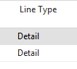
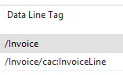
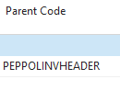
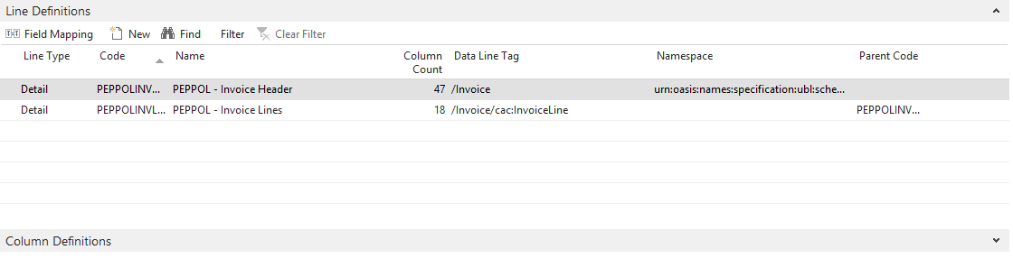
Line Definitions
Line for each repeatable node (Data Line Tag)
Linked to parent with Code
Namespace to verify the imported document
Notes:
The basic setup for a Data Definition are the Line Definition.
Each data file can have x number of line definitions. Xml and Json files can have multiple levels. Xml files can also have namespaces and there are built in functions to verify the namespace for the file being imported. (click)
For one line there are sublines and for that subline other sublines. (click)
The structure is built up by selecting the correct Parent Code in each line. The first level of lines does not have a Parent Code. (click)
Line types are informational entry. You are free to use the line type in your custom import. Line types, in standard code, are only used in the Positive Pay Export feature.

Slide 7
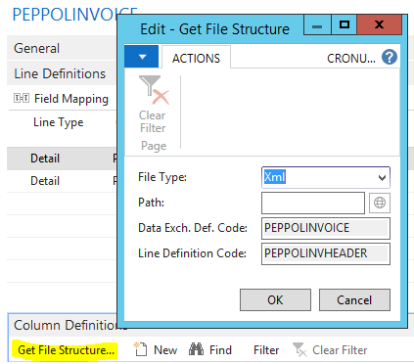
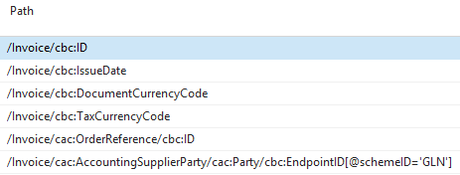
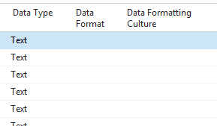
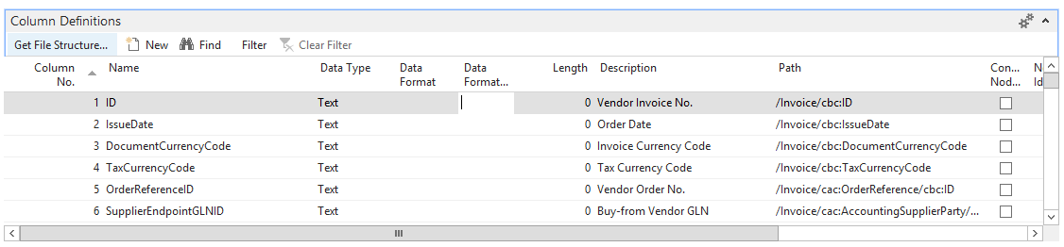
Column Definitions
Columns defined for each Line Definition
Constant, Substring, Column or a Node Path
Define formatting here or use Transformation Rules
Import existing Xml/Json to automatically create columns
Notes:
For each Line Definition we add a number of columns. When importing a fixed width text file we need to define the length for each field. When importing a delimited text file we define a column per line. Every file type can have a constant value in a field. (click)
Xml and Json files have Paths. For Xml files we can include a filter by attribute – as you can see in the last line - since the import Codeunit 1203 is using the FindNodeName method to import the data. If you install the enhancement from my blog you will also be able to use wild chars and have multiple columns with the same path. (click)
Here you can also define a Data Format and a Data Format Culture. If this is used then you don‘t use the Transformation Rule that can be defined in the Field Mapping, coming in the next slide. The Transformation Rules are new in NAV 2016 and I suggest that you use them and leave these formatting columns empty. (click)
If you have the Xml og the Json file you can get the file structure from that file and NAV will create lines for all paths in that file. If you have more than one Line Definitions you will have to do this for every line definition and make sure to remove all columns that do not belong to the Line Definition you are working on.

Slide 8
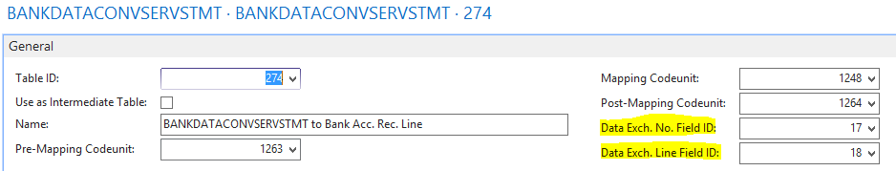
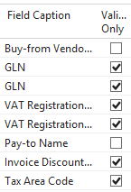
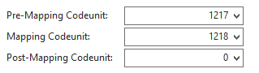
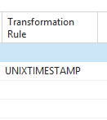
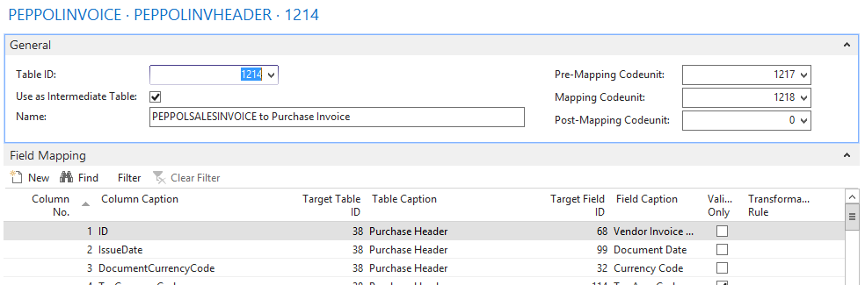
Field Mapping
Defined for each Line Definition
Break each Line Definition onto a dedicated table
Consider using the Intermediate Table that requires Codeunit 1214 for Data Handling.
Notes:
Each Line Definition has a field mapping. There are two ways to map data to tables. One is to create a direct mapping for each destination table by selecting the table and define mapping. Another way is to use an intermediate table. Using an intermediate table will allow you to map to multiple tables within the same mapping setup. It is also easier to create a general import structure by using the intermediate table as the import code will use record and field references for data writing. (click)
The mapping codeunits will insert the data into the destination tables. We always use a mapping codeunit but the pre- and post- mapping is optional and depends on the process requirements. For example; the pre-mapping is used for PEPPOL invoices where the data in the intermediate table is updated before the mapping codeunit uses that data to create the purchase invoice and –lines. (click)
For each field mapping we can define a transformation rule. I will go deeper into Transformation Rules a little later (click)
In some cases you might want to use the data you are importing for validation only. You can find examples of this in the PEPPOL import where the VAT Registration number in the incoming invoice is validated against the VAT Registration number in Company Information. (click)
Finally there are two hidden fields in the field mapping. These fields are required for bank statement import and for g/l journal import. Inside the bank account reconciliation you can dig into all the details for the imported line. The details will show you all the fields from the data exchange by filtering on these two values. If you want to enable a drill down to the details in your import you should add these fields to the destination table. Doing this also requires you to retain the data in the import working tables until the data in the destination table is deleted.

Slide 9
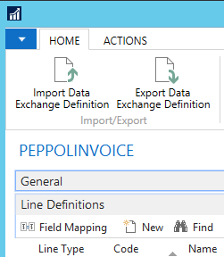
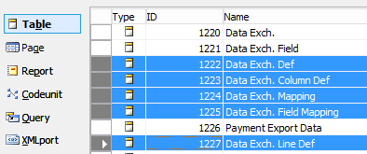
Summarize
Create a Data Exchange Definition
Define Lines
Define Columns
Define Mapping
Does not import or export Transformation Rules
Notes:
To put the whole process together on a single slide. You create a data exchange definition by defining the processes to use, define the lines that are repeated, define the columns for each line and finally map these columns to the destination table or tables. (click)
This setup is stored in these five tables. (click)
And you have a way to export and import the definition with a built in Xmlport. (click)
One warning though – the standard Xmlport does not export or import the Transformation Rules. So, as my friend and fellow MVP Kamil always sais, that is on you.
The Currency Exchange Rate Service is a nice example of how to build an simple user interface that takes care of all these configuration. I suggest you study that functionality and apply that method if you find it useful.

Slide 10
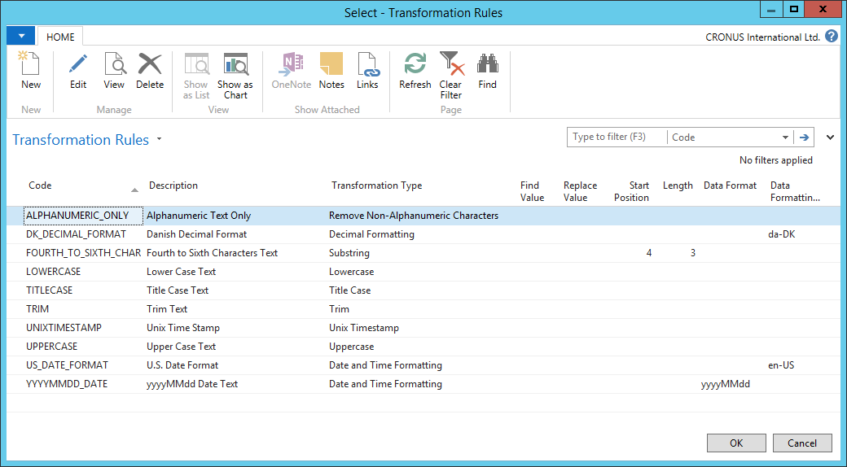
Transformation Rules
Convert a text value to NAV understandable text value
Flexible – a good thing
Not extensible in 2016 – a poor thing but fixed in 2017
Notes:
So, Transformation Rules
They are applied when data if copied from the Data Exchange Field table, either to the destination table or to the intermediate table. A Transformation Rule takes the imported value as a text and also returns a text value. (click)
These are examples of Transformation Rules. If we look at the second line we will receive a decimal formatted with the Danish culture. The Data Format and the Data Formatting Culture are DotNet settings so you look at the DateTime and the Decimal DotNet types on MSDN to find examples on how to use these. This second line rule will evaluate the imported text to a decimal with the Danish Culture settings and return a text variable that formats the decimal with standard NAV function. That means that the standard evaluate function will return the correct value during the final step.
Finally, the transformation rules are note limited to the Data Exchange Framework. You can easily use these functions anywhere in your custom functions

Slide 11
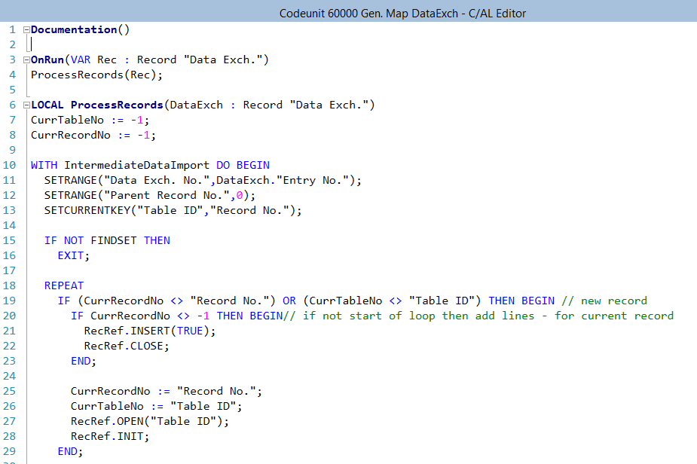
Next Steps
For Data Import/Export
Find or create the required Codeunits and XmlPorts
Link to User Interface
General Import
Use general mapping Codeunit that can import from the Intermediate table into the destination table
Notes:
You might need to create your own Codeunits or Xmlports to handle the import. If needed you should be able to use the standard ones, which I will detail in the coming slides, as a template. A Data Import needs to be started by the user og by the Job Queue. In any case the Data Exchange Definition Code needs to be saved in a setup, like in the Currency Exchange Service, or you need to prompt the user each time. (click)
My favorite is to use the Intermediate Table and I have created a Codeunit that, in some cases you can use directly, or in any case use as a template for the data import. I will put this Codeunit on my blob in a few days – so stay tuned.

Slide 12
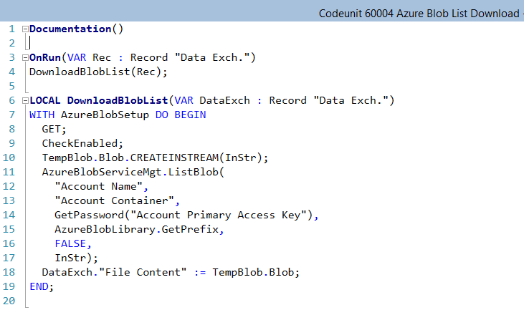
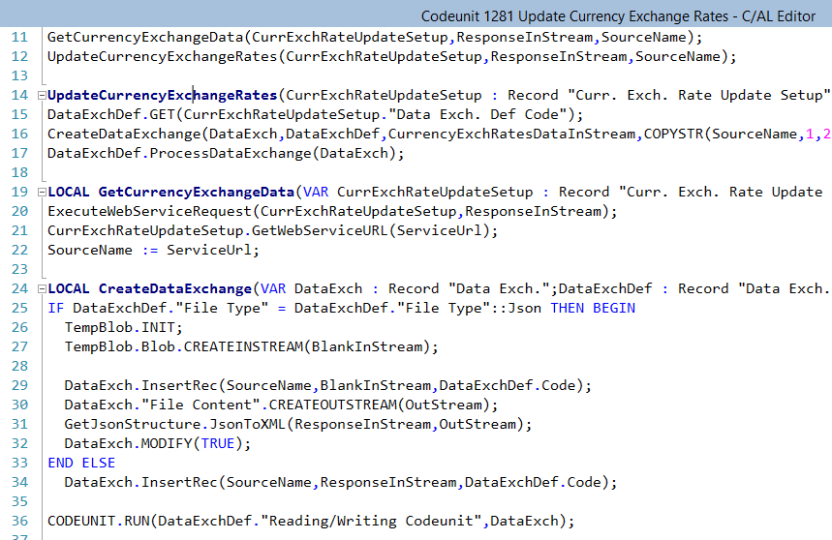
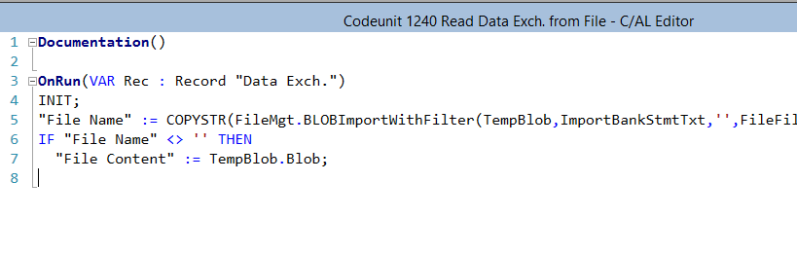
External Data Handling Options
Loads the data into the File Content field (3) in Data Exchange table 1220
Codeunit 1240 will prompt the user for a client file to import
Codeunit 1281 will download currency exchange rate
Build a custom Codeunit to fetch the data
Notes:
The first step in any data import is to get the basic data file into NAV. The Data Exchange table 1220 is the basic table for the Data Exchange. That table has a BLOB field for the file content. There basically are two ways to get the data into that BLOB field; manually or automatically. (click)
Codeunit 1240 is an example of how to do this manually. By selecting this Codeunit as the External Data Handling Codeunit the user will be prompted for a local file and the standard method from Codeunit 419 will be used to upload the client file into the BLOB. (click)
Codeunit 1281, that is a part of the Currency Exchange Rates Services, has an example of how the file content is downloaded from a web service and then handled by the Data Exchange Framework. If you look at the slide you will see in line 11, calling a function in line 19 where the ExecuteWebServiceRequest is executed. The result from the web service is returned as an input stream that is copied into the Data Exchange File Content BLOB in line 30 or line 34. (click)
Finally I am showing a custom code that I created that will download a list of files from the Azure Blob Storage Service. Last year I created a solution to store NAV Attachments in the Azure Blob Storage Service and have been using that solution as a demo since then. The beauty of that solution is that it is using most of the new features in NAV 2016 and it is also capable of being a standalone NAV extension. Looking at the code you will see that the response Input stream created in line 10 is populated with the AzureBlobService call in line 11 and copied to the Data Exchange File Content field in line 18.
You most likely can imagine a multiple ways of getting your import data into that BLOB field. I try to use the built in functions in codeunit 419, File Management, if possible and in most cases I use the TempBlob table as a container for the data while working on it.

Slide 13
Reading Codeunit/XmlPort
Data read from the File Content field (3) in Data Exchange table (1220) to Data Exchange Field table (1221)
Codeunit 1203 reads Xml/Json based on Path
XmlPort 1220 reads CSV
Codeunit 1241 reads fixed width text file (enhanced to support encoding)
Codeunit 1200 reads Xml/Json based on Node
Create your own
Every value stored as text
Notes:
Having gotten the data file into NAV, the next task is to import the data into the Data Exchange Field table no. 1221. When debugging you can stop the import after this step and look at the result in that table. When you remove a record from the Data Exchange table no. 1220 the relevant entries are removed from the Data Exchange Field table – if you trigger the DELETE code. Yes the import is always working on real database tables – not temporary instances – so you need to take care of the cleanup.
In most cases you should be able to use the standard codeunits or xmlports for this step. I have not yet found a case where I need to create my own code to handle this step.
To elaborate on the difference between Codeunit 1203 and Codeunit 1200. Codeunit 1200 will read through the Xml og Json file and look for the matching path in the Column Definition table. Codeunit 1203, on the other hand, will loop through the Column Definitions and using the NameSpaceManage look for the matching node in the Xml or Json file. Therefore, if you want to be able to select nodes based on the attributes, you need to use Codeunit 1203.

Slide 14
Data Handling
Data read from the Data Exchange Field table (1221) into the Intermediate Data Import table (1214)
Always needed if using Intermediate Table in the Field Mapping
Recommended for general import
Notes:
The Data Handling step is only used if you select to use the Intermediate Table 1214. In standard, there is only one Codeunit that does this job and that is Codeunit 1214. If you follow the basic rule of having a separate table for each Line Definition you should be able to use this Codeunit unchanged.
I like to recommend using this intermediate method for general data import.
As an example, when you add an Xml file to your Incoming Document NAV will try all the defined Data Exchange Types and simply select the type that has the largest count of records in the Intermediate Table.

Slide 15
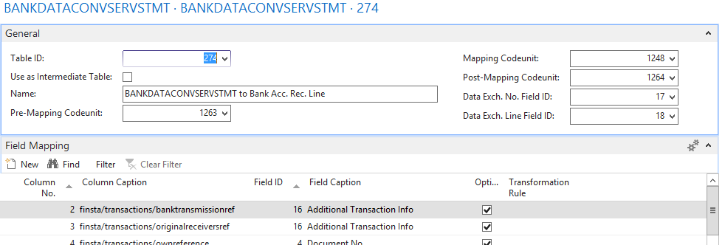
Field Mapping
Using Intermediate Table (e.g. PEPPOL)
Pre-Mapping Codeunit updates and adds entries the the intermediate table
Mapping Codeunit reads the intermediate table and inserts the data into the destination tables
Post-Mapping Codeunit validates the import
Using Destination Table (e.g. Bank Statement)
Pre-Mapping and Post-Mapping Codeunits not used
Basic rule – Use as needed
Notes:
Finally, the Codeunits you would like to use for the final mapping function. It depends on the process if you need to use the pre- or post-mapping Codeunits. If you look at the standard Data Exchange Definitions you will see that sometimes all three are used and sometimes only one. For general import I have only needed to use one but for bank statement import I have used the post-mapping to get the totals for the import and populate the bank account reconciliation totals.

Slide 16
Ask about what people would like to spend time on

Slide 17
Payment Export
Payment Export settings on Bank Account Card. If not specified then
Codeunit 1270, “Exp. Launcher Gen. Jnl.” is started.
Gets Data Exch. Def. Code from Bank Export/Import Setup
Creates new Credit Transfer Register
Executes “Data Handling Codeunit” – none
Executes “Validation Codeunit” – none
Creates Data Exch. Record via Codeunit 1210
Updates all G/L lines with that Data Exch. Entry No.
Starts DataExch.ExportFromDataExch

Slide 18
DataExch.ExportFromDataExch
Tests for Mapping Codeunit
Starts Pre-Mapping Codeunit 1283 – FillExportBuffer (1226)
Starts Mapping Codeunit 1274 – Copy data to Field table (1221)
Starts Post-Mapping Codeunit 1275 – Creates CreditTransFerEntries
Starts Writing Codeunit – 85008 – Creates the Xml based on Fields (1221) – xmlport 85000
Xml is now in “File Content” BLOB on table 1220
Starts Ext. Data Handling Codeunit – 85009 – writes the Xml to a Web Service.
Starts User Feedback Codeunit – 0

Slide 19
Added import functions
Codeunit 85203. Copy of 203 with two changes
Can select to use the node name as value (useful for Json Currency Stream)
Can have multiple fields with the same note path (can have multiple mappings of the same data)
Codeunit 89341
Can import flat files for multiple line definitions and supports different textencoding
Codeunit 85037
Can read XSLX (Excel Xml Documents)
40,762516, -73,974190

Slide 20
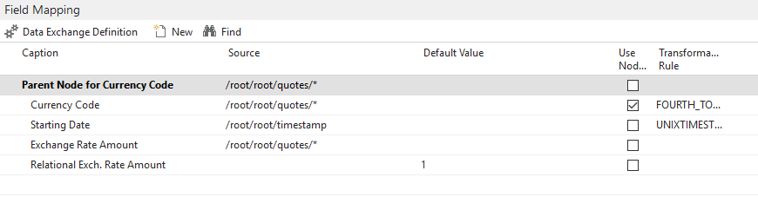
Currency Import
http://www.apilayer.net/api/live?access_key=09f219a816ccc41ce2158bcf9277c477
Add new field “Use Name as Value” to tables 1223 and 1265 and page 1216 and 1265.
This field is used in import Codeunit 85203
The mirroring between the buffer (1265) and the Column Def. (1223) is handled with events in Codeunit 89204 (note a bugfix in Codeunit 1225).
Create the Currency Exchange Rate Service and add the Url.
Edit the Data Definition to change the import Codeunit and set as Json.

Slide 21
Exercise: Weather Forecast Solution
Url :=
STRSUBSTNO(
http://graphical.weather.gov/xml/sample_products/browser_interface/ndfdXMLclient.php?lat=%1&lon=%2&product=time-series&begin=%3&end=%4&maxt=maxt&mint=mint',
FORMAT(Latitude,0,9),
FORMAT(Longitude,0,9),
FORMAT("Start Date & Time",0,'<Year4>-<Month,2>-<Day,2>T<Hours24,2>:<Minutes,2>:<Seconds,2>'),
FORMAT("End Date & Time",0,'<Year4>-<Month,2>-<Day,2>T<Hours24,2>:<Minutes,2>:<Seconds,2>')
);

Slide 22
Objects: Weather Forecast Solution
Tables:
81000 – Weather Forecast Request
for date & time, location and result
81001 – Weather Forecase Buffer
for mapping the intermediate fields
Codeunits:
81000 – Weather Forcase Management
functions to get location and execute the Data Exchange
81001 – Download from web service to Data Exchange
81002 – Transformation Rule to convert Fahrenheit to Celsius
Pages:
81000 – List page for table 81000.
access to actions to get location and download weather forecast
88806 – Get location from location service (or manual if not enabled)

